Slide 1
Estimating Future Oil & Gas Production in Texas
Traditionally, EIA Annual Energy Outlook (AEO) forecasts have been used to estimate future production.
For shale areas in Texas, Hubbert’s Method has been used.
For the rest of Texas, the EIA AEO forecasts are used.
Have also graphed historical production data from 2008 through 2017 for the eight geologic areas of Texas for comparison

Slide 2
Hubbert’s Method
Based on the Hubbert Peak Curve theory, production tends to follow a bell-shaped curve.
Using an estimated ultimate recovery volume and historical production data for an area, a best-fit curve is used to estimate future production.
Theory was first published by M. King Hubbert in 1962, in the National Academy of Sciences publication 1000-D.

Slide 3
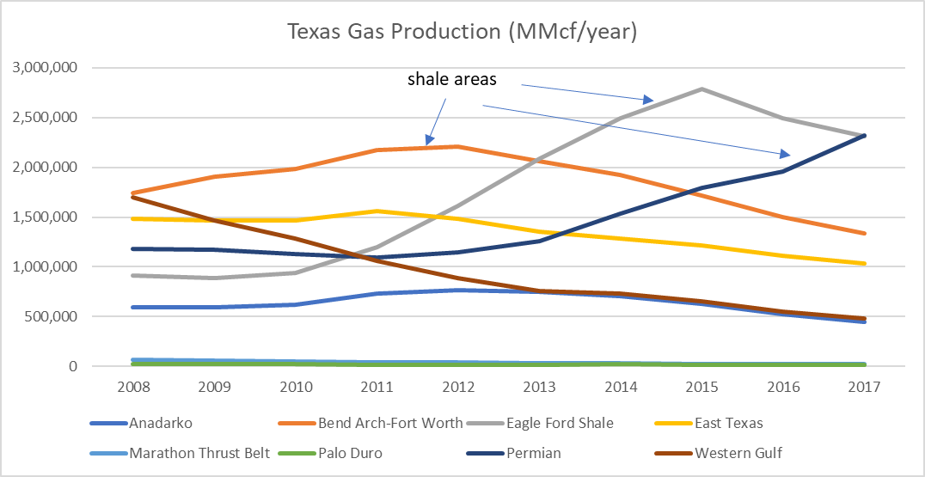
Historical Production in Texas (cont.)

Slide 4
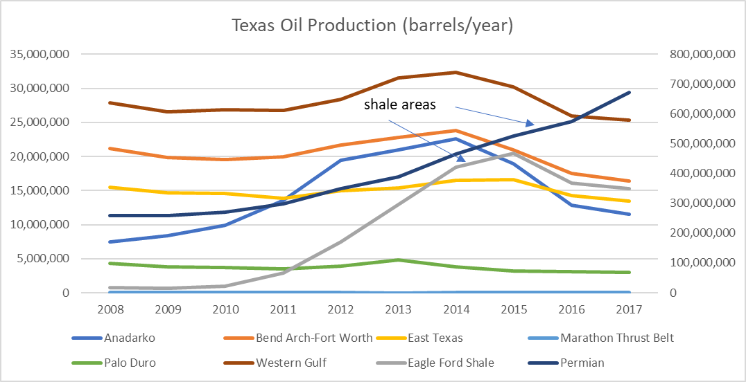
Historical Production in Texas (cont.)

Slide 5
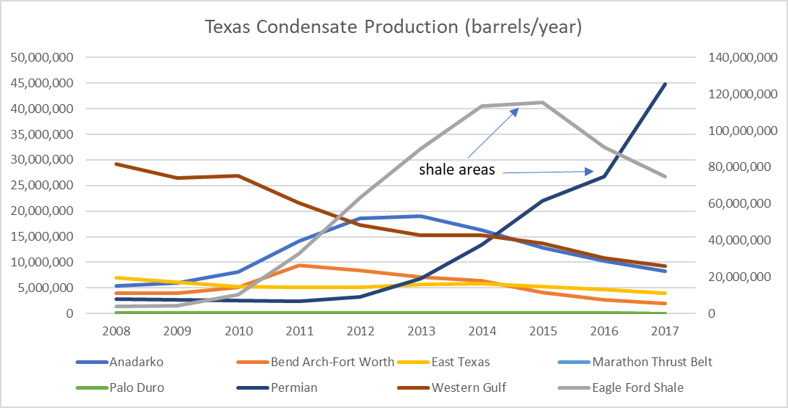
Historical Production in Texas (cont.)

Slide 6
Observations
For shale areas, production does seem to follow a bell-shaped curve for gas and condensate
Oil production seems to follow price much more closely for all areas
For most of the non-shale areas, production looks fairly flat or is decreasing slightly
May be easiest to project no growth to 2023 & 2026
Or verify that the EIA projections show no growth
Production in the Permian Basin continues to increase
Not sure how long the growth will last
Not sure how high the peak will be

